Slide 1
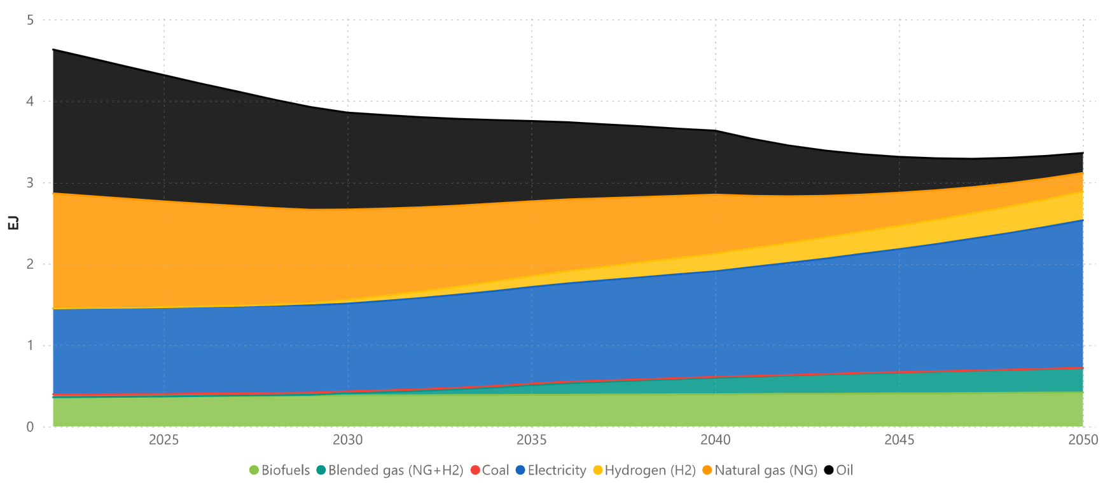
2022

Slide 2
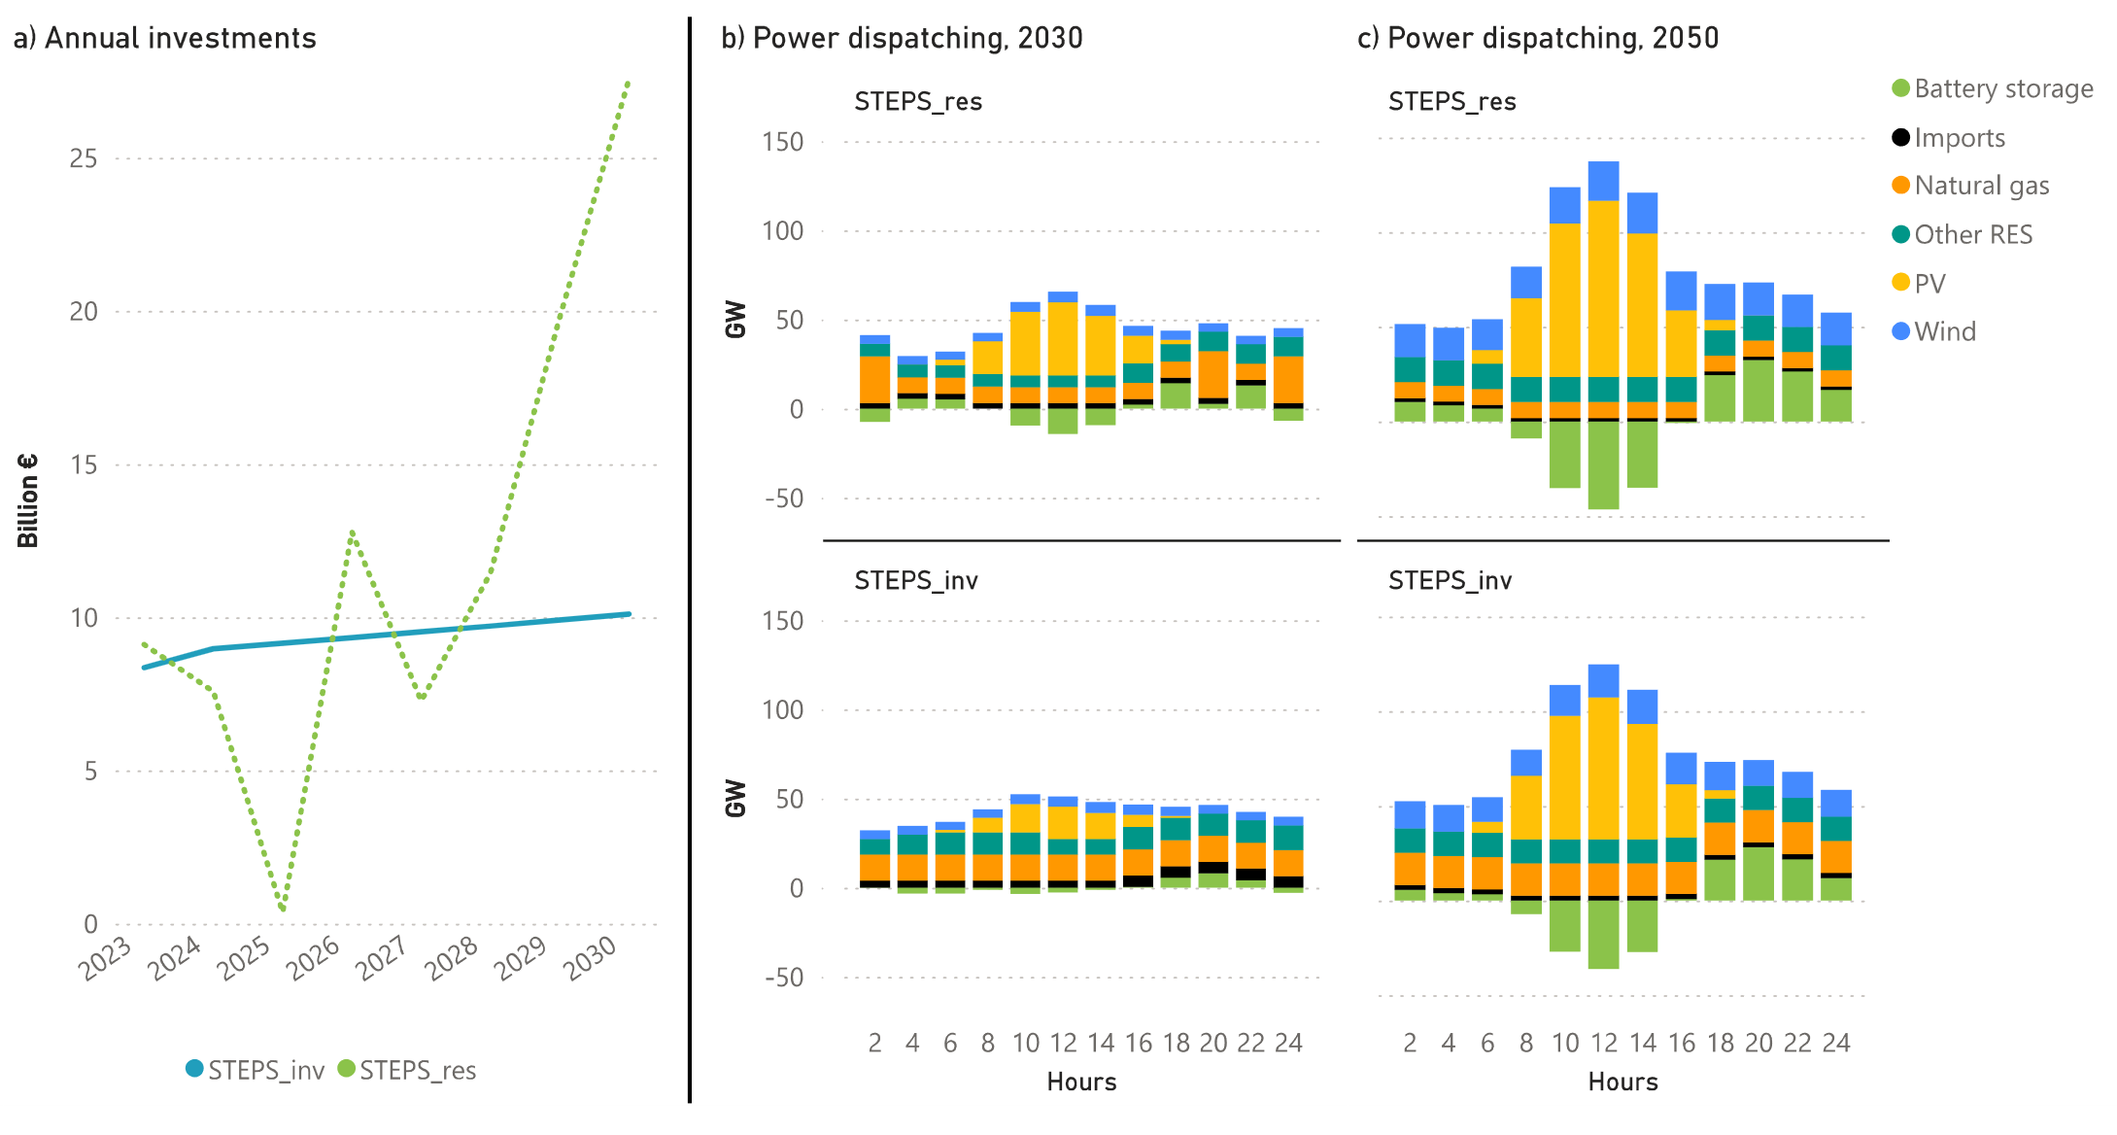

Slide 3
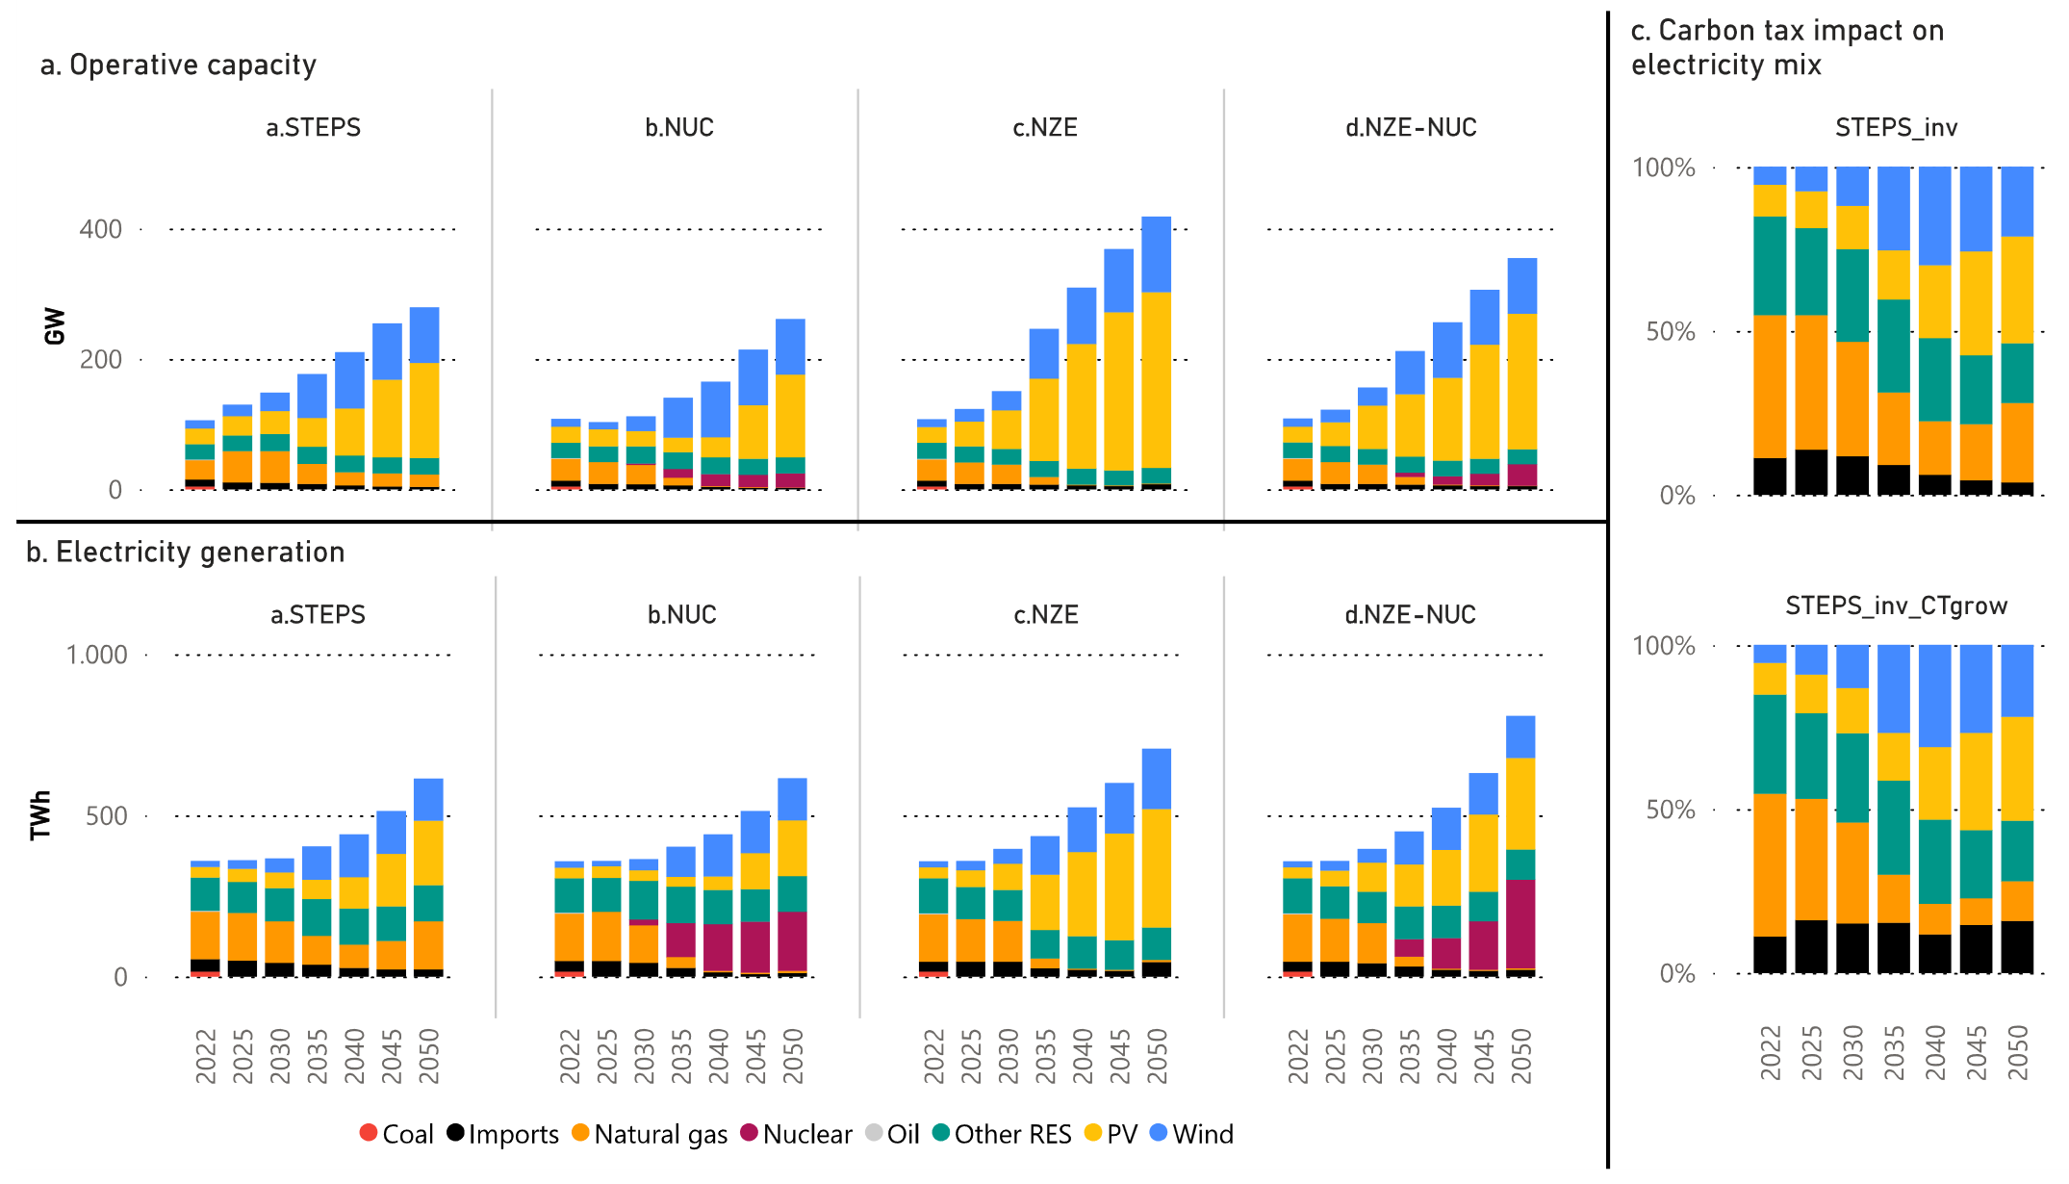
STEPS_inv (100€/kgCO2)
Natural gas: 24%
Imports: 4%
STEPS_inv (500€/kgCO2)
Natural gas: 12%
Imports: 16%

Slide 4
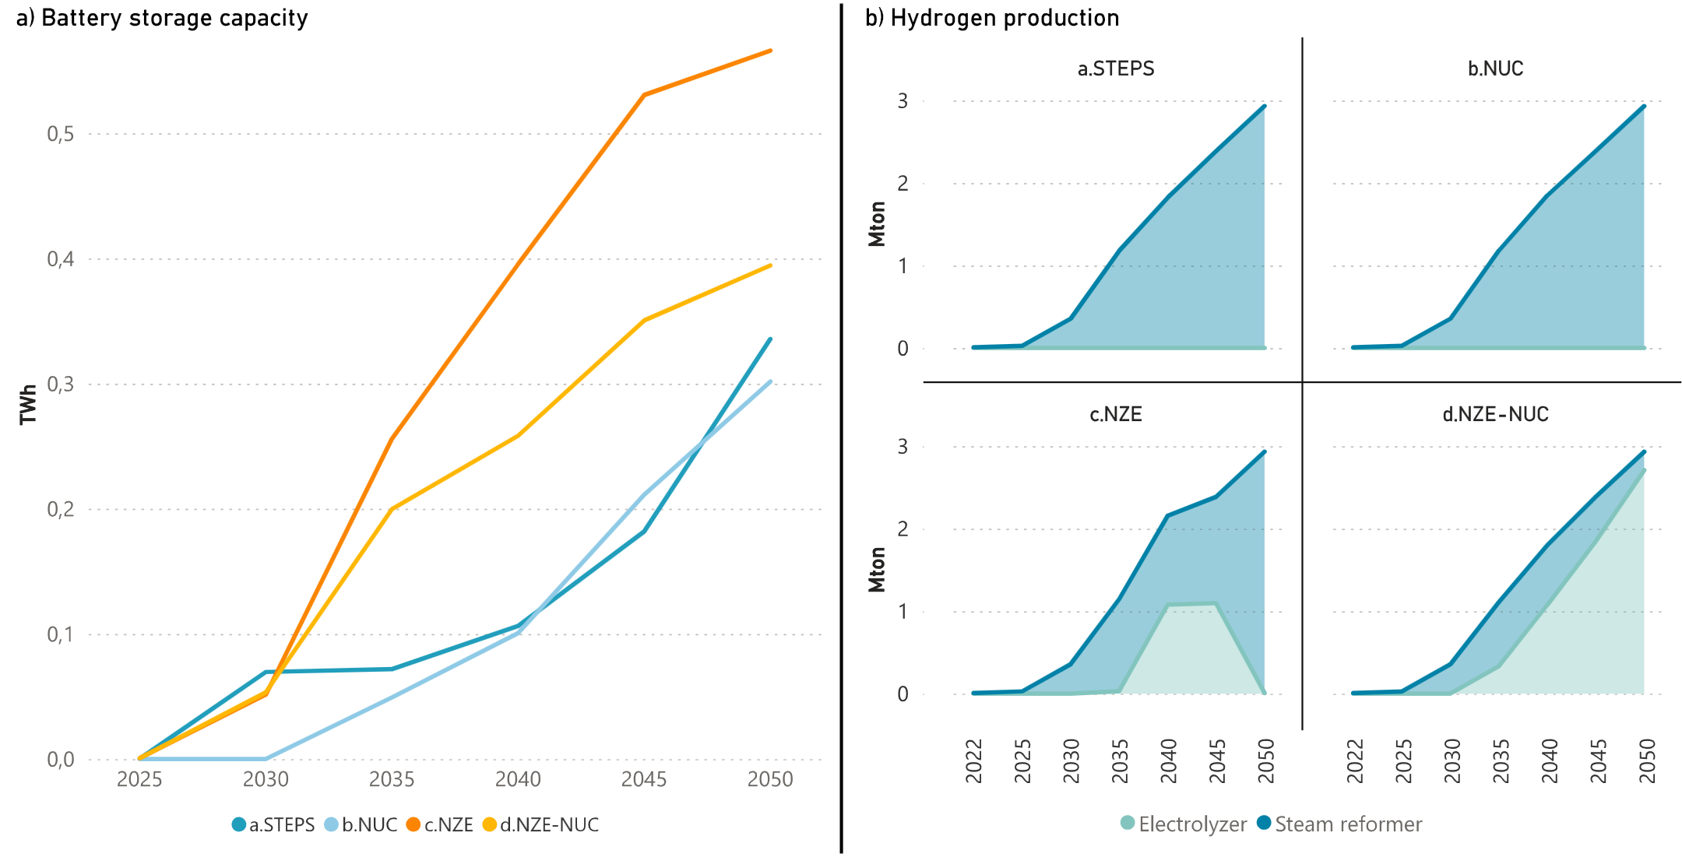

Slide 5
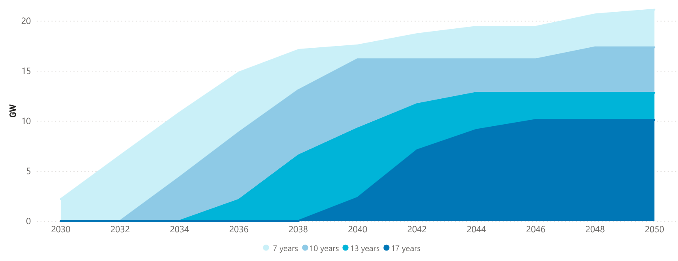
21.1
17.3
12.8
10.1

Slide 6
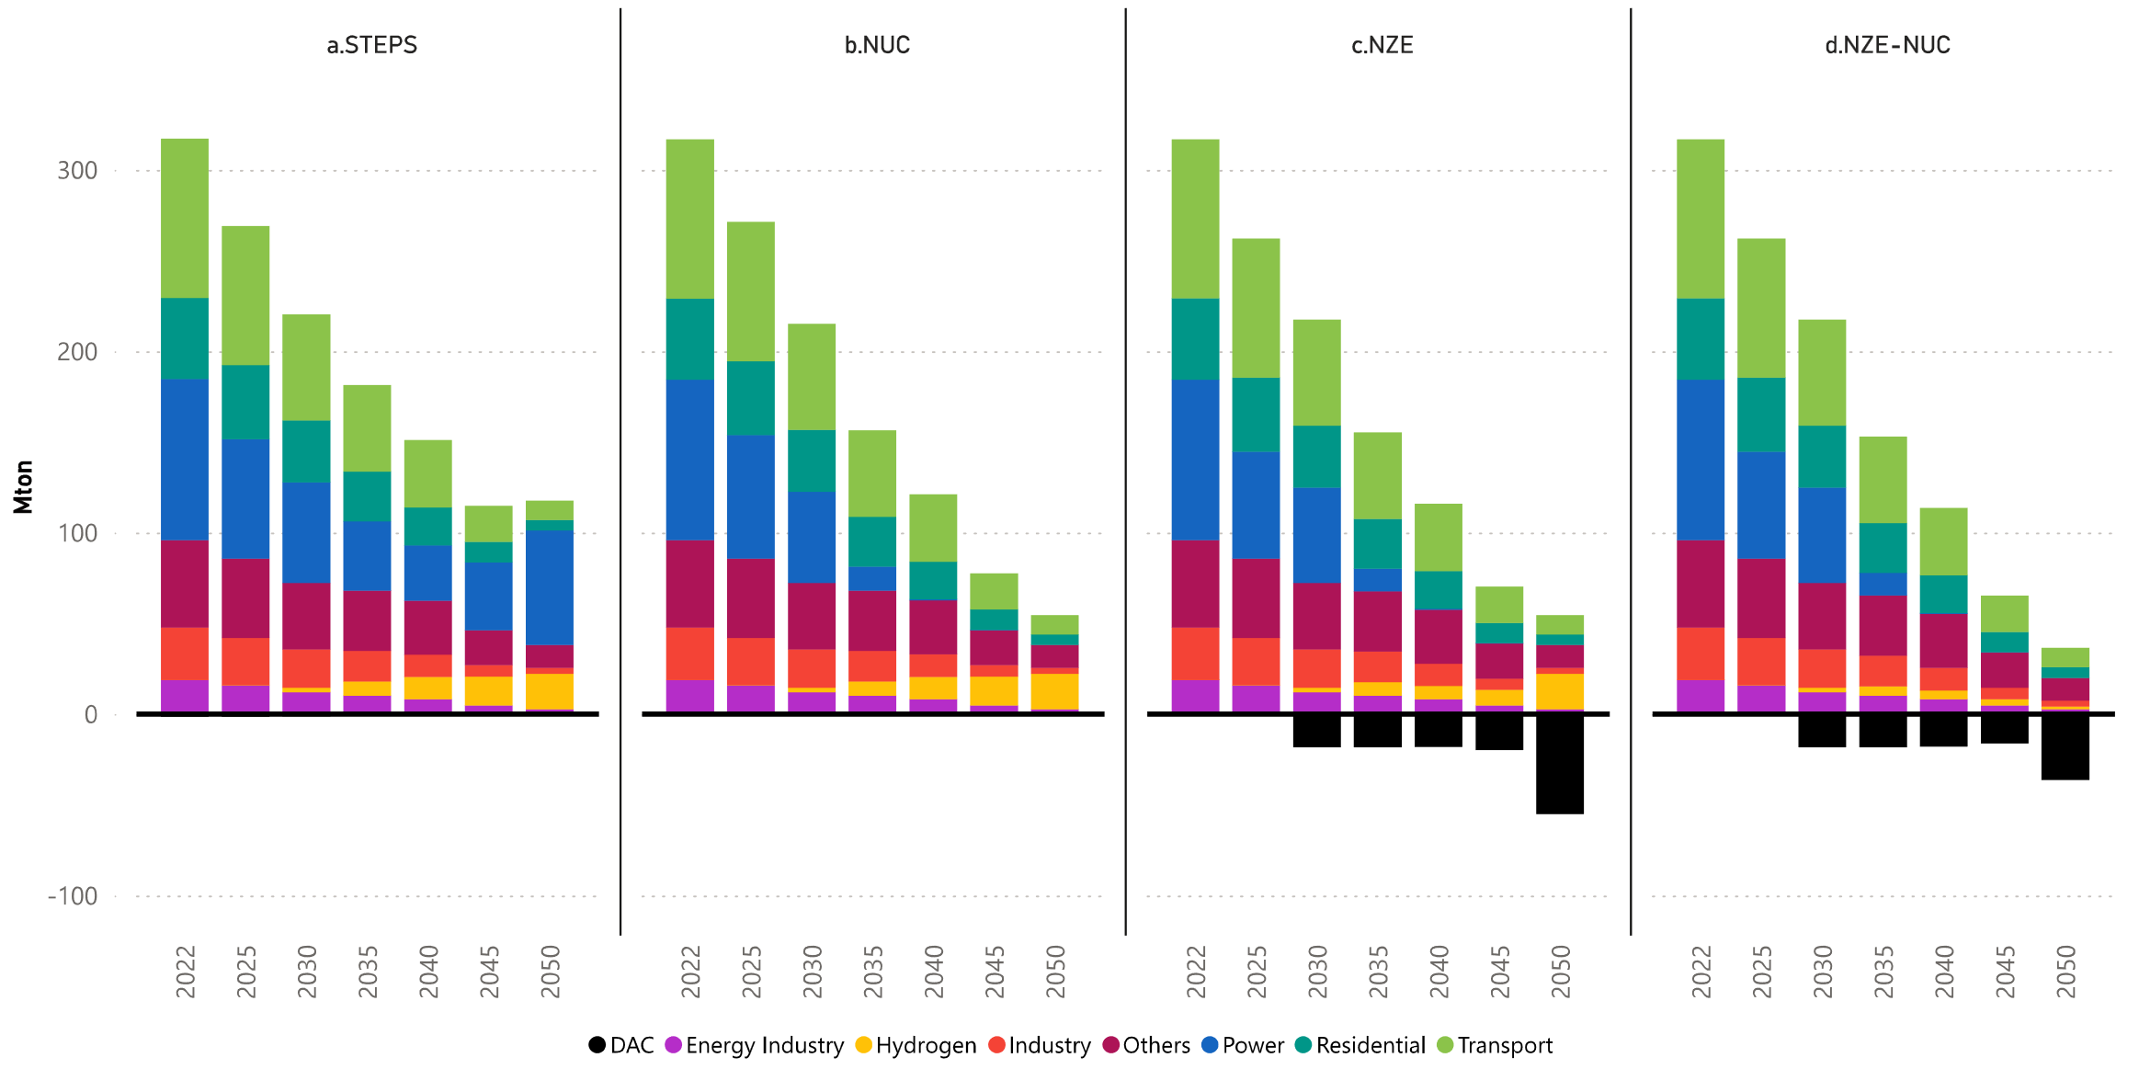

Slide 7
